Slide 1
First Year Day Student Advising Session for Spring 2020
Featuring:
Dean of Students, Paul Manrique
Director of Law Student Support, Keri Hickey

Slide 2
What We’re Covering Today
Planning for your future
Executing the plan
Completing the experiential requirement

Slide 3
Remaining Curriculum Requirements
You pick the course!

Slide 4
Classes Already Taken:
Fall 2019
Spring 2020
Introduction to Lawyering Skills (ILS)
Contracts I
Criminal Law
Civil Procedure I
Torts
16 credits
Introduction to Advocacy
Contracts II
Civil Procedure II
Property
Constitutional Law I
16 credits

Slide 5
Remaining Curriculum Requirements
Professional Responsibility
Evidence
Constitutional Law II
Law in Context
Scholarly Writing
Seminar
Approved Journal Comment
Experiential
Live Client – 6 credits OR
Live Client – 3 credits PLUS Simulation – 3 credits
87 Credits
Do not wait until the last semester to take required courses.

Slide 6
Timing Tips
Upper Level Required Courses | Fall 2020 | Spring 2021
LAW 620-624 Law in Context | 1 Summer section 1 Fall section | 2 sections
LAW 651 Evidence | 1 section | 2 sections
LAW 652 Professional Responsibility | 2 sections | 1 section
LAW 655 Constitutional Law II | 2 sections | 2 section

Slide 7
Rules and Reasoning (LAW 615)
GPA below 2.80 after the first year
Connected to a doctrinal subject (e.g. R&R: Remedies, R&R: Employment Law, R&R: Advanced Civil Procedure)
Will need to take in the fall 2020 or spring 2021 term. Plan accordingly.
Notes:
This upper-level course is to assist students in developing the skills necessary for success in law school, on the bar exam, and in practice.
Students will work on (1) learning how to read and analyze legal concepts, (2) synthesizing complicated materials, (3) communicating effectively both orally and in writing, (4) developing the essential skills for the mastery of their law school courses, and (5) improving their writing skills. Professors teaching this course will use a doctrinal subject of their choosing (e.g., agency, remedies, employment law) and teach students the mastery of skills involved in identifying legal issues, understanding and using rules of law, and using and analyzing facts. Students will have multiple opportunities for practice and feedback and will engage in exercises designed to help students master the skill of legal analysis using a doctrinal subject as a framework for doing so [Admission by permission only]

Slide 8
Experiential Requirement
6 credits
3 must be live client
Clinics, externships, and workshops
Timing Tip: Pre-Req & Co-Req: Evidence and Professional Responsibility

Slide 9
Planning resources
Degree Audit feature (called “Academic Requirements” on MyUB)
Learn how to access resources in myUB using How to Guides for Students published on the Records and Registration website
Curriculum Planning Guide
Academic advisors & Faculty
Email ublawacadaff@ubalt.edu to connect with an advisor
Law School’s Academic Policies and Procedures Manual
Concentrations & Practice Areas– Explore the many areas of study online. Look at the concentration requirements to start planning.

Slide 10
Creating a roadmap
 | FALL | SPRING | SUMMER
20/21
21/22

Slide 11
A Word about taking courses elsewhere
At Maryland Law & Other Law Schools
At other Graduate Schools
Online Courses
Abroad

Slide 12
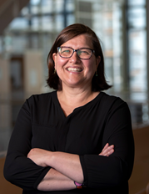
Clinical Education – Introduction

Slide 13
Available Clinics:
6 Credit Clinics:
Civil Advocacy Clinic
Civil Advocacy Clinic: Topic – Human Trafficking Prevention Project*
Community Development Clinic*
Criminal Practice Clinic
Family Law Clinic
Immigrant Rights Clinic
Innocence Project Clinic (2 semesters)*
Legal Data & Design Clinic*
Tax Clinic*
Veteran's Advocacy Clinic*
3 Credit Clinics:
Mediation Clinic for Families*
Mental Health Law Clinic
* these clinics are designed to accommodate evening students

Slide 14
How do I register?
Advance Registration – March 30-April 7

Slide 15
Registration - Basics
REGISTRATION BEGINS AT 8:30am on your enrollment date
Check for HOLDS before your enrollment appointment
Read the registration instructions every semester
Where to find useful information:
The Current Students Tab on the School of Law website allows you to access
Semester information
Class Schedule, Registration Instructions
Academic Calendar
Course Descriptions
How-To Guides for Students available on Records and Registration web site

Slide 16
Registration - Basics
Maximum Credit Load
Full time – Maximum 16 credits
Part time – Maximum 12 credits
Wait List Policy
In order to move off a waitlist, the new course must not create a time conflict and may not exceed your maximum credit load for the term. You also cannot be enrolled in another section of the same course.

Slide 17
Registration - Basics
Section Numbers and Divisions
Cross Division Registration – Class sections with numbers in the 300s or 400s are restricted to the day or evening section, respectively.
You may not enroll or waitlist a class section that is restricted from you until cross-division registration.
Cross division registration will open to all currently enrolled students on Tuesday, April 7 at 8:30am.

Slide 18
Register via myUB My Student Center

Slide 19
Navigating your Student Center
2
1
Search for classes (search), add them to your shopping cart to await your enrollment appointment (plan), and enroll in classes (enroll).
Check your Holds – Click Details for more information
Check your Enrollment Appointment
3

Slide 20
Search for Classes on myUB
Select Term
Look for a specific course using the course number (catalog number)
Search using course keyword if you don’t know the number
Course Component: Filter for seminar, clinical, workshop or lecture.
Filter for meeting times
1
2
5
3
4

Slide 21
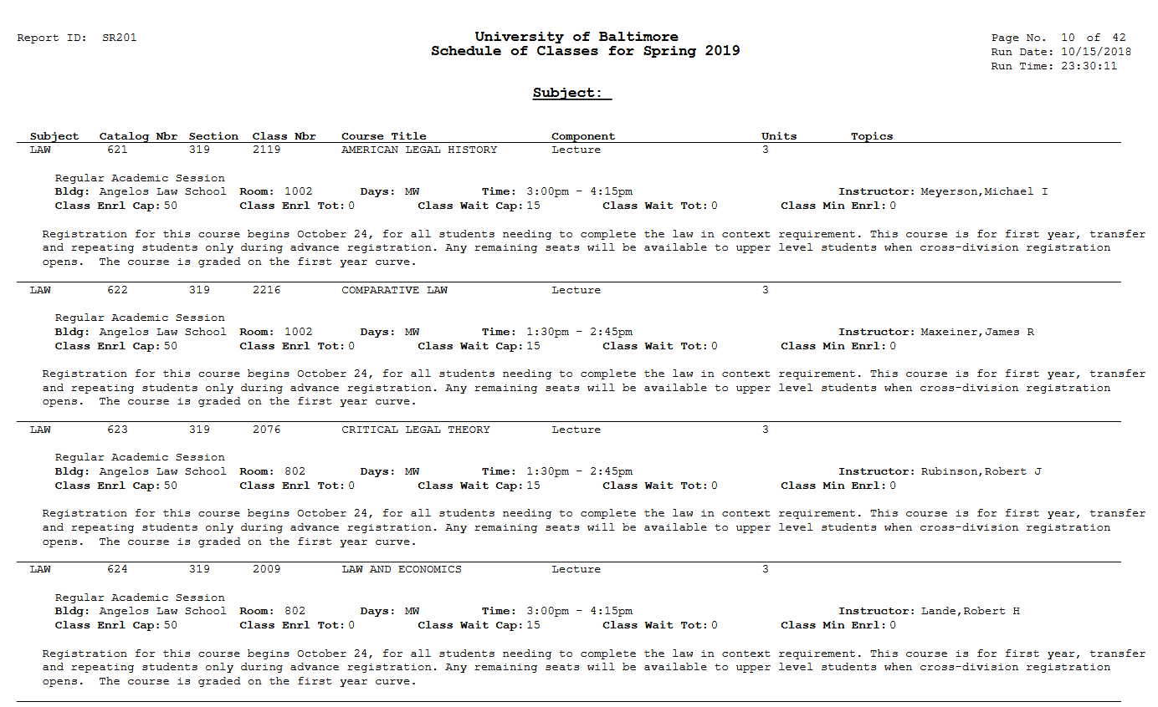
Or Find Class Numbers on the PDF version of Schedule of Classes
Link to Schedule of Classes

Slide 22
Enroll in Classes using Search or Class Numbers
Click Enroll on myStudent Center under Academics
Enter 4 digit class number to put the class directly in your shopping cart
Search for classes to add to your shopping cart

Slide 23
Office of Academic Affairs
Dionne Koller, Associate Dean for Academic Affairs
Paul Manrique, Asst. Dean for Students
Keri S. Hickey, Director of Law Student Support
Katie Shifflett, Student Affairs Coordinator
Gregory Bordelon, Director for Bar Success
Claudia Diamond, Asst. Dean for Academic Support
Laurie Harow, Asst. Dean for Enrollment and Academic Planning
Katie Rolfes, Administration (bar certifications)

Slide 24
This is your legal education. Take charge and shape it!
If you have a question or need support, please do not hesitate to ask. We are here to help.
pmanrique@ubalt.edu
khickey@ubalt.edu
Good luck!

